Slide 1
BOOTCAMP

Slide 2
Bootcamp
Web Level 1
HTML dan PHP Dasar

Slide 3
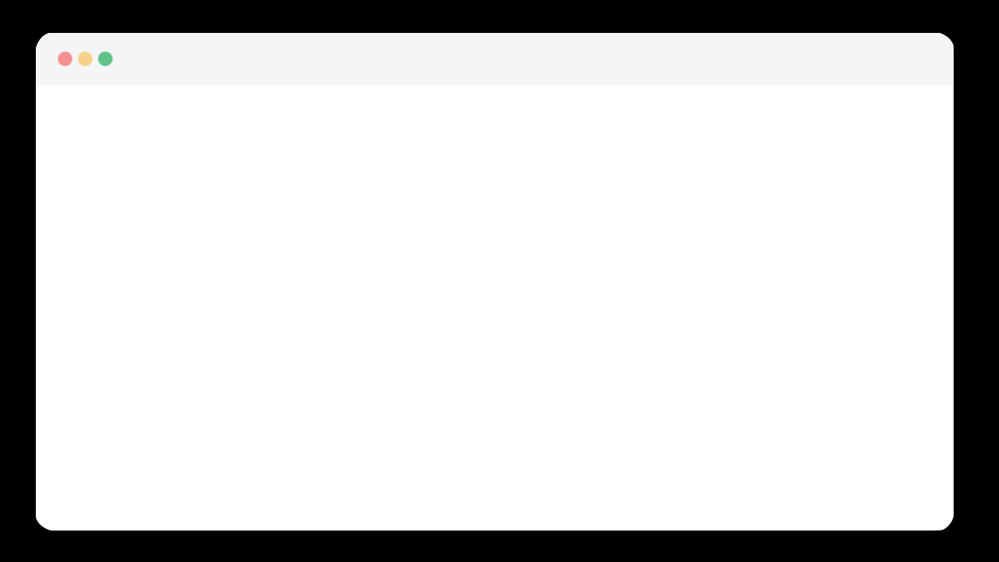


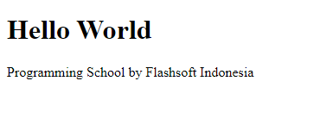






Bootcamp
Flashsoft
Indonesia
Web Level 1
Admin
HTML
Editor + Browser
Elemen HTML
CSS
Bootsrap
Grid Layout
Download Template

Slide 4
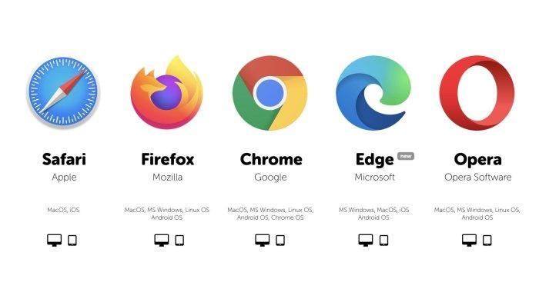




Bootcamp
Flashsoft
Indonesia
Web Level 1
Admin
HTML
Editor + Browser
Text Editor
Browser
Elemen HTML
CSS
Bootsrap
Grid Layout
Notepad
Notepad ++
Download Template
Sublime Text 3
Visual Studio Code

Slide 5
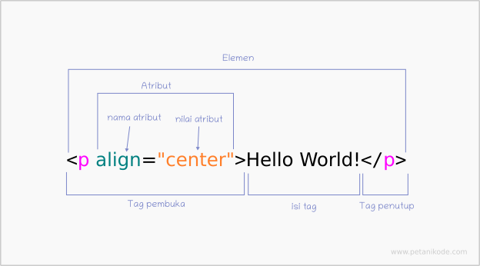
Bootcamp
Flashsoft
Indonesia
Web Level 1
Admin
HTML
Editor + Browser
Elemen HTML
CSS
Bootsrap
Grid Layout
Download Template

Slide 6
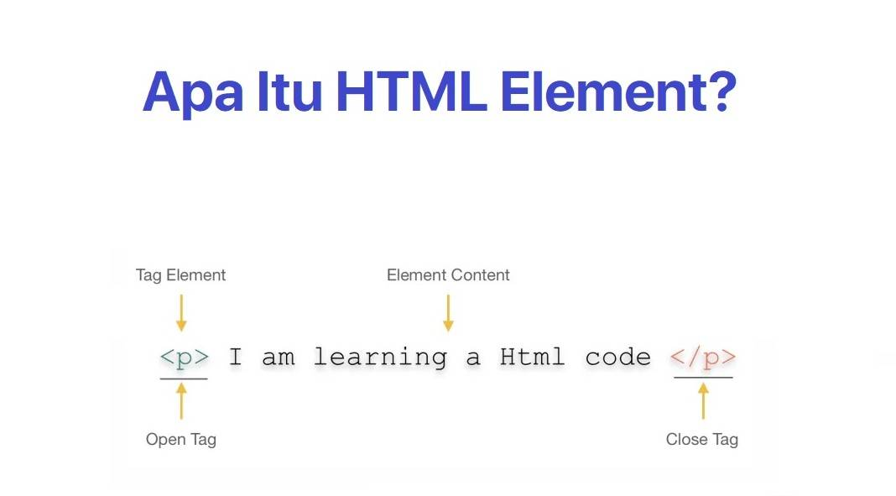
Bootcamp
Flashsoft
Indonesia
Web Level 1
Admin
HTML
Editor + Browser
Elemen HTML
CSS
Bootsrap
Grid Layout
Download Template

Slide 7
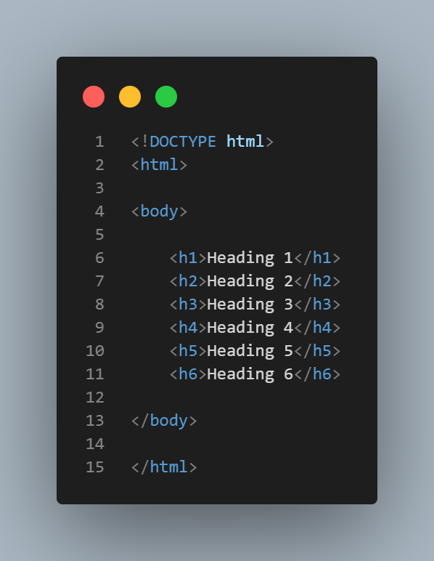
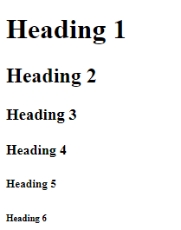
Bootcamp
Flashsoft
Indonesia
Web Level 1
Admin
HTML
Koding
Output
Editor + Browser
Elemen HTML
CSS
Bootsrap
Grid Layout
Download Template

Slide 8
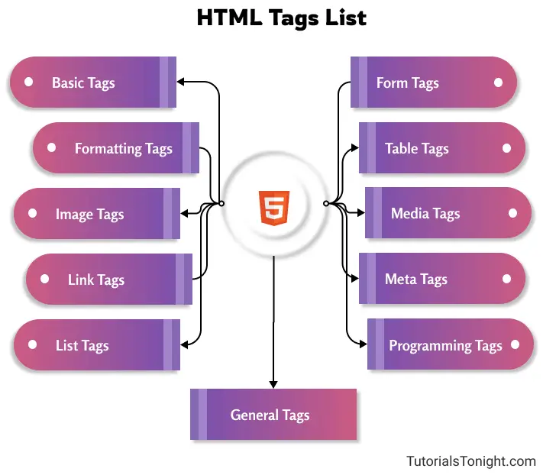
Bootcamp
Flashsoft
Indonesia
Web Level 1
Admin
HTML
Editor + Browser
Elemen HTML
CSS
Bootsrap
Grid Layout
Download Template

Slide 9
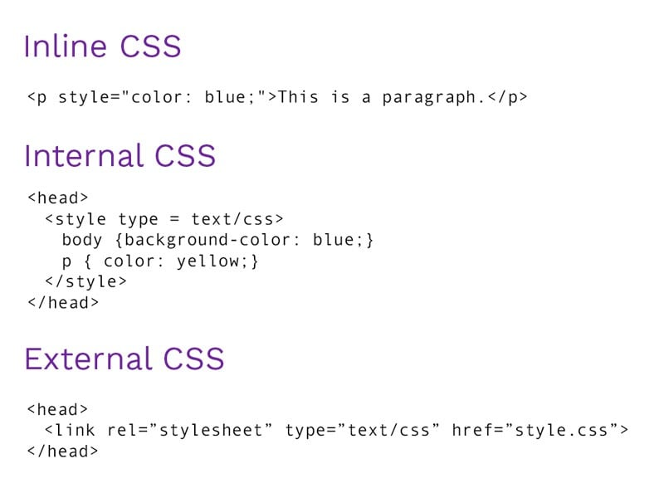
Bootcamp
Flashsoft
Indonesia
Web Level 1
Admin
HTML
Editor + Browser
Elemen HTML
CSS
Bootsrap
Grid Layout
Download Template

Slide 10
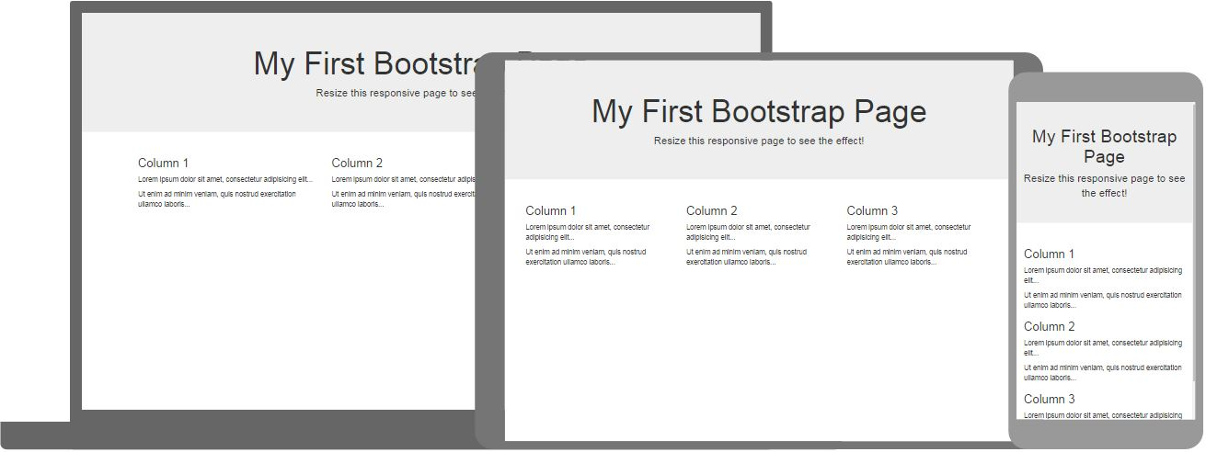
Bootcamp
Flashsoft
Indonesia
Web Level 1
Admin
HTML
Editor + Browser
Elemen HTML
CSS
Bootsrap
Grid Layout
Download Template

Slide 11
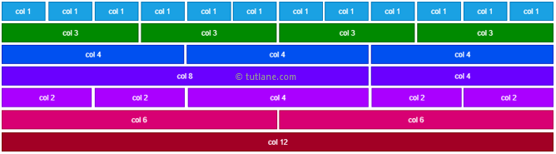
Bootcamp
Flashsoft
Indonesia
Web Level 1
Admin
HTML
Editor + Browser
Elemen HTML
CSS
Bootsrap
Grid Layout
Download Template

Slide 12

Bootcamp
Flashsoft
Indonesia
Web Level 1
Admin
HTML
Editor + Browser
Elemen HTML
https://w3layouts.com
https://colorlib.com
https://freebiesbug.com
https://templatemo.com
https://templatemo.com/tm-578-first-portfolio
CSS
Bootsrap
Grid Layout
Download Template

Slide 13
Thank You
Flashsoft Indonesia

